Slide 1

BASICS OF
ELECTRONICS
Understanding the Fundamentals of Electronics
and components.

Slide 2
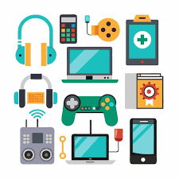
WHAT IS
ELECTRONICS?
  Electronics is the study and use of electrical circuits that involve active electrical components such as transistors, diodes, and integrated circuits.
  Everyday Applications: Smartphones, computers, home appliances, and medical devices.

Slide 3

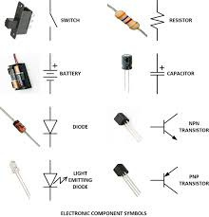
BASIC ELECTRONICS
COMPONENTS
  Resistors: Control the flow of current
  Capacitors: Store and release electrical energy
  Inductors: Store energy in a magnetic field
  Diodes: Allow current to flow in one direction
  Transistors: Act as switches or amplifiers

Slide 4
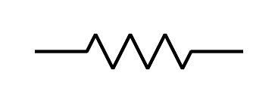
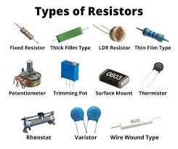
RESISTORS
  Function: Limits electric current in a circuit
  Unit: Ohms (Ω)
  Types: Fixed, variable, thermistor

Slide 5
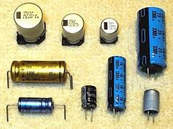
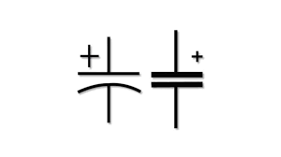
CAPACITORS
  Function: Store and discharge electrical energy
  Unit: Farads (F)
  Types: Electrolytic, ceramic, film

Slide 6
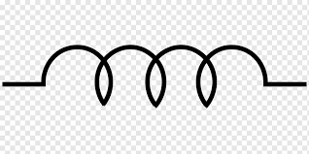
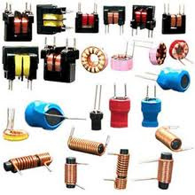
INDUCTORS
  Function: Store energy in a magnetic field
  Unit: Henry (H)
  Used in: Filters, transformers, tuning circuits

Slide 7
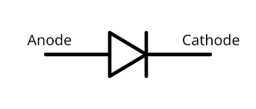
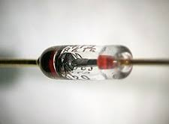
DIODES
  Function: Allow current to flow in only one direction
  Types: Rectifier, Zener, Light Emitting Diodes (LEDs)

Slide 8
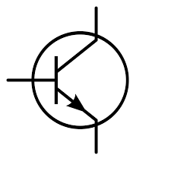

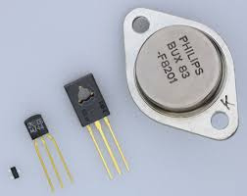
TRANSISTORS
  Function: Work as amplifiers and switches
  Types: Bipolar Junction Transistor (BJT), Field Effect Transistor (FET)
  Used in: Microprocessors, amplifiers, switching circuits

Slide 9
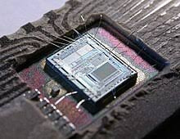
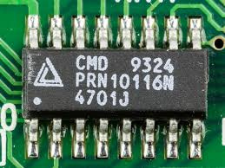
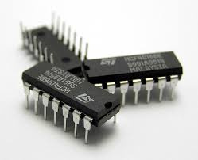
INTEGRATED CIRCUITS (ICS)
  Definition: A combination of multiple electronic components in a single package
  Applications: Computers, mobile phones, appliances
  Types: Analog ICs, Digital ICs

Slide 10
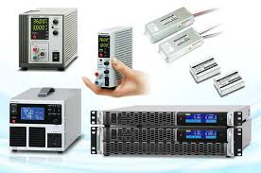
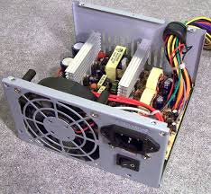
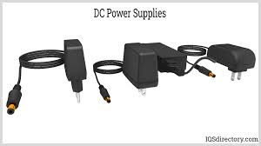
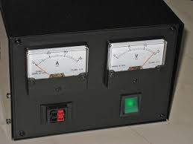
POWER SUPPLY BASICS
  Function: Converts electrical energy to usable form
  Types: AC-DC Adapters, Batteries, Solar Power

Slide 11
THANK
YOU

